Slide 1

Professional Exam
Online Workshop
2025

Slide 2
FORMAT OF THE WORKSHOP
Format and content of the examination
Exit Level Outcome (ELO)
Preparing for the Applied Pharmacy Practice in a Legal Framework paper
Preparing for the Applied Pharmaceutics and Pharmaceutical Chemistry paper
Preparing for the Applied Pharmacology and Toxicology paper
Remote online examination/assessment
Examination results
Appeal process
Q &A

Slide 3



FORMAT OF THE PROFESSIONAL EXAMINATION
Professional Examinations | Applied Pharmacy Practice in a Legal Framework | Applied Pharmaceutics and Pharmaceutical Chemistry | Applied Pharmacology and Toxicology
Open book online examination 3 examination papers multiple choice questions (MCQs) 3 days Pass mark 50% No negative marking | Integrated exam Pharmacy Administration Professional Pharmacy Practice and Ethics, Legislation case study practice scenario questions 120 MCQ Four (4) hours. Subminimum of 40% Overall pass mark 50% | Two parts Pharmaceutics Pharmaceutical Chemistry Three (3) hours 90 MCQ Subminimum of 40% Overall pass mark 50% | Basic Principles of Pharmacology and Toxicology Three (3) hours 90 MCQ Pas mark 50%

Slide 4
WEIGHT PER EXIT LEVEL OUTCOME (ELO) PER SUBJECT
Professional exam (300 MCQ) |  | Applied Pharmacology and Toxicology (90 MCQ) | Applied Pharmacy Practice in a Legal Framework (120 MCQ) |  | Applied Pharmaceutics and Pharmaceutical Chemistry (90 MCQ)
ELO | Total | Pharmacology (90 MCQ) | Pharmacy Practice (60 MCQ) | Law and Ethics (60 MCQ) | Pharmaceutics (50 MCQ) | Pharmaceutical Chemistry (40 MCQ)
1 | 12% | 5.55% | 3.33% | 1.66% | 14% | 52.5%
2 | 9.67% | 0 | 0 | 3.33% | 24% | 30%
3 | 6% | 0 | 0 | 13.33% | 20% | 0
4 | 10.33% | 0 | 0 | 10 | 42% | 17.5%
5 | 6.33% | 0 | 15% | 16.67% | 0 | 0
6 | 16% | 30% | 13.33% | 21.67% | 0 | 0
7 | 14.67% | 31.11% | 25% | 1.67% | 0 | 0
8 | 11.67% | 20% | 15% | 13.33% | 0 | 0
9 | 8% | 13.33% | 15% | 5% | 0 | 0
10 | 5.33% | 0 | 13.33% | 13.33% | 0 | 0
11 | 0 | 0 | 0 | 0 | 0 | 0
TOTAL | 100% | 30% | 20% | 20% | 17.0% | 13%

Slide 5
EXAM CONTENT: EXIT LEVEL OUTCOMES
ELO 1
ELO 2
ELO 3
ELO 4
Integrate and apply foundational scientific principles and knowledge to pharmaceutical sciences.
Apply integrated knowledge of product development and formulation in the compounding, manufacturing, distribution and dispensing of pharmaceutical products.
Compound, manipulate and prepare medication in compliance with Good Pharmacy Practice (GPP) rules, Good Manufacturing Practice (GMP) and/or Good Clinical Practice (GCP) guidelines.
Manage the manufacturing, packaging and registration of pharmaceutical products in compliance with GMP and GCP.

Slide 6
EXAM CONTENT: EXIT LEVEL OUTCOMES
ELO 5
ELO 6
ELO 7
ELO 8
Manage the logistics of the selection, procurement, storage, distribution and disposal of pharmaceutical products.
Dispense medication and ensure optimal pharmaceutical care for the patient in compliance with GPP and, where applicable, GCP.
Apply a pharmaceutical care management approach to ensure rational medicine use.
Initiate and/or modify therapy, where appropriate, within the scope of practice of a pharmacist and in accordance with GPP and GCP, where applicable.

Slide 7
EXAM CONTENT: EXIT LEVEL OUTCOMES
ELO 9
ELO 10
ELO 11
Promote public health.
Integrate and apply management principles in the practice of pharmacy.
Participate in research.

Slide 8



ELO 1
12%
Physical, chemical and biological principles are integrated and applied in the development, formulation, compounding, manufacturing, drug supply management and dispensing of pharmaceutical products.
  Demonstrate ethical and professional conduct related to the relevant scope of practice in the provision of pharmaceutical technical support services
Anatomical, physiological, biochemical and pathophysiological principles and knowledge are integrated and applied in the initiation and/or modification of therapy and provision of pharmaceutical care.
  Apply basic scientific principles and perform basic scientific calculations
Social and behavioural principles and knowledge are integrated and applied in the initiation of therapy and provision of pharmaceutical care.

Slide 9


ELO 2
9.67%
Physicochemical and biopharmaceutical principles are applied in the formulation and development of pharmaceutical products. Pick, pack and secure orders for medicines or scheduled substances according to all requirements and check that orders are dispatched according to SOPs.
Physical, chemical and biological principles are applied in the manufacturing, compounding and quality assurance of pharmaceutical products.
Physicochemical and biopharmaceutical principles are applied in compounding and dispensing of pharmaceutical products.
Pharmaceutical product integrity is maintained during storage and distribution according to GPP.

Slide 10

ELO 3
6%
Standard Operating Procedures (SOPs) are generated and implemented in compliance with GPP.
Pharmaceutical preparations are compounded in accordance with GMP. Participate in manufacturing processes for non-sterile medicines and scheduled substances.
Sterile admixtures are produced in accordance with aseptic techniques and principles of GMP and GPP.
Records are generated for each of the preparations produced according to organisational procedures and legal requirements.

Slide 11

ELO 4:
10.33%
Medicines registration dossiers for pharmaceutical products using the supplied data and documentation are compiled in accordance with the current relevant legislation.
Master production documentation for the manufacture of pharmaceutical products is interpreted in terms of GMP.
The GMP requirements for generation and reconciliation of batch manufacturing documents are described.
Dosage forms are manufactured on a laboratory scale according to plan and standard operating procedures.
Packaging, labelling and package inserts are contextualised according to the product, GMP and the current relevant legislation.
A Quality Management System (QMS) is critically evaluated in accordance with GMP.

Slide 12
ELO 5:
6.33%
The selection of medicines and related products is managed according to rational, scientific and evidence-based principles and patient needs.
The quantity of medicines needed is identified according to standard methods.
The procurement of medicines and related products is managed according to organisational policies and procedures.
Pharmaco-economic knowledge, principles, models and theories are applied in the provision of cost-effective therapy and pharmaceutical services.
The storage and distribution of medicines and related products is managed according to Good Pharmacy Practice (GPP), Good Distribution Practice (GDP) and Good Wholesaling Practice (GWP).
Disposal of expired and unwanted pharmaceutical products is managed according current relevant legislation and guidelines.

Slide 13
ELO 6:
16%
The prescription is evaluated in terms of the appropriateness of the prescribed medication according to GPP.
Medicines are prepared and labelled in accordance with GPP and current legislative requirements.
Appropriate drug information sources and information systems are accessed, and the relevant information is communicated to the patient and/or carer in order to optimise therapeutic outcomes.
A pharmaceutical care plan, including design, implementation and monitoring, is developed in collaboration with other health care professionals and the patient.
Records are kept in accordance with the GPP and current legislative requirements.

Slide 14
ELO 7:
14.67%
The philosophy and principles of pharmaceutical care are demonstrated in terms of optimising therapeutic outcomes for a specific patient.
A pharmaceutical care management approach is applied in collaboration with other health care professionals and the patient.
Rational drug use is facilitated by applying pharmaceutical care, medicine utilisation reviews and the principles of pharmaco-economics.
Pharmacovigilance is practised and Adverse Drug Events are reported.

Slide 15
ELO 8:
11.67%
Relevant clinical information and history is obtained from the patient.
Appropriate advice, including referral, and/or medicines are supplied for specific symptoms according to GPP and principles of pharmaceutical care.
In the case of possible medicine interactions, or any other possible contraindications, appropriate modification of therapy is suggested in consultation with the prescriber.
Appropriate records are kept, and therapeutic outcomes monitored in accordance with GPP and principles of pharmaceutical care.

Slide 16
ELO 9:
8%
Disease prevention and disease management is provided in terms of use of medicinal and non-medicinal options.
Tools are designed to inform the public on health care and lifestyle, in health promotion, disease prevention, disease management and medicine usage, in addition to enabling the recognition and management of risk factors.
Promotive health services are offered in terms of current health policy, epidemiological information and current legislative requirements.
The public are assisted to recognise and manage health risk factors in terms of medication and disease states.
Screening tests are used to assist in counselling, therapeutic intervention, referral and early detection of disease.
Appropriate records are kept, and therapeutic outcomes monitored in accordance with GPP and pharmaceutical care principles.

Slide 17
ELO 10:
5.33%
Basic financial management principles are applied in the practice of pharmacy.
Human resource management principles are applied in the practice of pharmacy.
Strategic management principles are applied in the practice of pharmacy.
Marketing management and change management principles are applied in the practice of pharmacy.
Logistics management principles are applied throughout the medicines supply chain.
Relationships with patients, caregivers and other healthcare professionals and workers are managed in accordance with professional practice standards.
Risk management principles are applied in the practice of pharmacy.
Quality improvement principles and strategies are continuously applied.

Slide 18




TYPES OF QUESTIONS

Slide 19
PREPARATIONS
Admin
Prepare
How can I prepare?
Which references do I need?
Exam
How does the online exam work?
How long is the exam?
What do I need to bring?
How do I use the references?
When (date and time) is the exam?
Where (venue/remote) is the exam?
What resources do I need?

Slide 20
WEIGHT PER EXIT LEVEL OUTCOME (ELO) PER SUBJECT
Professional exam (300 MCQ) |  | Applied Pharmacology and Toxicology (90 MCQ) | Applied Pharmacy Practice in a Legal Framework (120 MCQ) |  | Applied Pharmaceutics and Pharmaceutical Chemistry (90 MCQ)
ELO | Total | Pharmacology (90 MCQ) | Pharmacy Practice (60 MCQ) | Law and Ethics (60 MCQ) | Pharmaceutics (50 MCQ) | Pharmaceutical Chemistry (40 MCQ)
1 | 12% | 5.55% | 3.33% | 1.66% | 14% | 52.5%
2 | 9.67% | 0 | 0 | 3.33% | 24% | 30%
3 | 6% | 0 | 0 | 13.33% | 20% | 0
4 | 10.33% | 0 | 0 | 10 | 42% | 17.5%
5 | 6.33% | 0 | 15% | 16.67% | 0 | 0
6 | 16% | 30% | 13.33% | 21.67% | 0 | 0
7 | 14.67% | 31.11% | 25% | 1.67% | 0 | 0
8 | 11.67% | 20% | 15% | 13.33% | 0 | 0
9 | 8% | 13.33% | 15% | 5% | 0 | 0
10 | 5.33% | 0 | 13.33% | 13.33% | 0 | 0
11 | 0 | 0 | 0 | 0 | 0 | 0
TOTAL | 100% | 30% | 20% | 20% | 17.0% | 13%

Slide 21
Types of questions Pharmacy Practice and Law & Ethics
120 questions in total:
  60 – Pharmacy Practice (PP) and
  60 - Law and Ethics (L&E)
Level of cognition
  Knowledge ≤ 5%;
  Application ≥ 50% (case study and scenarios based);
  Problem Solving ≤ 45%

Slide 22
REFERENCE MATERIAL:
APPLIED PHARMACY PRACTICE IN A LEGAL FRAMEWORK
The pharmacist is required to be cognisant of all legislation relating to pharmacy practice including the Pharmacy Act, 53 of 1974, the Medicines and Related Substances Act, 101 of 1965 and other relevant acts.
PSSA Pharmacy Law Compendium, Volumes 1 and 2, published by LexisNexis. The most recent service issue must be accessed. The Compendium is available from LexisNexis Customer Services at Tel: 0860-765-432 or e-mail address: customercare@lexisnexis.co.za or from the Pharmaceutical Society of South Africa (PSSA)
South African Medicines Formulary. Latest edition
Standard Treatment Guidelines (Department of Health South Africa) http://www.health.gov.za/index.php/standard-treatment-guidelines-and-essential-medicines-list/category/285-phc?download=2392:primary-healthcare-level-2014
Community Pharmacy: Symptoms, diagnosis and treatment. 4th edition. Rutter Paul.
Pharmacy Management, Any Edition., Alston, G., Desselle, S., & Zgarrick, D.
Communication Skills in Pharmacy Practice,
A selection has been made from texts that are readily available and will provide useful background reading for candidates:
  The Merck Manual of Diagnosis and Therapy. Latest Edition. Merck & Co. Inc. Rathway.
  Daily Drug Use. Talmud, J., Latest Edition. Tincture Press. Cape Town;
  Symptoms in Pharmacy, A. Blenkinsop.

Slide 23

Managing time
Maximising your time – 240 minutes
  120 MCQs
  4 options per MCQ
  Approximately 2 minutes per question
No negative marking
Do not leave anything blank
Notes:
Examiner / Moderator

Slide 24
WEIGHT PER EXIT LEVEL OUTCOME (ELO) PER SUBJECT
Professional exam (300 MCQ) |  | Applied Pharmacology and Toxicology (90 MCQ) | Applied Pharmacy Practice in a Legal Framework (120 MCQ) |  | Applied Pharmaceutics and Pharmaceutical Chemistry (90 MCQ)
ELO | Total | Pharmacology (90 MCQ) | Pharmacy Practice (60 MCQ) | Law and Ethics (60 MCQ) | Pharmaceutics (50 MCQ) | Pharmaceutical Chemistry (40 MCQ)
1 | 12% | 5.55% | 3.33% | 1.66% | 14% | 52.5%
2 | 9.67% | 0 | 0 | 3.33% | 24% | 30%
3 | 6% | 0 | 0 | 13.33% | 20% | 0
4 | 10.33% | 0 | 0 | 10 | 42% | 17.5%
5 | 6.33% | 0 | 15% | 16.67% | 0 | 0
6 | 16% | 30% | 13.33% | 21.67% | 0 | 0
7 | 14.67% | 31.11% | 25% | 1.67% | 0 | 0
8 | 11.67% | 20% | 15% | 13.33% | 0 | 0
9 | 8% | 13.33% | 15% | 5% | 0 | 0
10 | 5.33% | 0 | 13.33% | 13.33% | 0 | 0
11 | 0 | 0 | 0 | 0 | 0 | 0
TOTAL | 100% | 30% | 20% | 20% | 17.0% | 13%

Slide 25
WEIGHT PER EXIT LEVEL OUTCOME (ELO) PER SUBJECT
Professional exam (300 MCQ) |  | Applied Pharmacology and Toxicology (90 MCQ) | Applied Pharmacy Practice in a Legal Framework (120 MCQ) |  | Applied Pharmaceutics and Pharmaceutical Chemistry (90 MCQ)
ELO | Total | Pharmacology (90 MCQ) | Pharmacy Practice (60 MCQ) | Law and Ethics (60 MCQ) | Pharmaceutics (50 MCQ) | Pharmaceutical Chemistry (40 MCQ)
1 | 12% | 5.55% | 3.33% | 1.66% | 14% | 52.5%
2 | 9.67% | 0 | 0 | 3.33% | 24% | 30%
3 | 6% | 0 | 0 | 13.33% | 20% | 0
4 | 10.33% | 0 | 0 | 10 | 42% | 17.5%
5 | 6.33% | 0 | 15% | 16.67% | 0 | 0
6 | 16% | 30% | 13.33% | 21.67% | 0 | 0
7 | 14.67% | 31.11% | 25% | 1.67% | 0 | 0
8 | 11.67% | 20% | 15% | 13.33% | 0 | 0
9 | 8% | 13.33% | 15% | 5% | 0 | 0
10 | 5.33% | 0 | 13.33% | 13.33% | 0 | 0
11 | 0 | 0 | 0 | 0 | 0 | 0
TOTAL | 100% | 30% | 20% | 20% | 17.0% | 13%

Slide 26
Types of questions: Pharmaceutical chemistry
40 questions in total:
Level of cognition
  ~20 % Knowledge;
  40% Application;
  30% Problem solving

Slide 27
Pharmaceutical Chemistry Introduction
Knowledge of drug actions + controlling drug delivery across biological membranes and to drug receptor site + development of stable formulations and the design of sophisticated analytical methods - require understanding of basic physical, biophysical and organic chemistry - equally important for the development of traditional small molecule drugs and for biotechnology products.
The importance of pharmaceutical chemistry - emphasised in the study of inorganic and organic compounds in pharmacodynamic groupings e.g. sedatives, hypnotics, narcotics, steroidal and non-steroidal anti-inflammatory agents, tranquillisers, psychotropic drugs, anaesthetics, hormones, vitamins, chemotherapeutics, antibiotics and radiopharmaceuticals.
The synthesis, chemical reactions used for identification, biotransformation and structure relationships of these drugs - important to the pharmacist.

Slide 28
Pharmaceutical Chemistry Aim
The aim of the Professional Examination in applied Pharmaceutical Chemistry is to evaluate your knowledge of candidates of basic principles of organic pharmaceutical chemistry and structure-activity relationships that influence drug actions, general principles in molecular mechanisms of drug action, analysis of substances of pharmaceutical importance, the actions of drugs in biochemical terms and pharmaceutical chemistry in drug design.

Slide 29
Pharmaceutical Specific Outcomes
The basic principles of organic pharmaceutical chemistry and structure-activity relationships that influence drug actions
You should have an understanding of:
The principles of organic chemistry + structures of organic compounds + the reactions of organic functional groups in the synthesis of organic compounds of pharmaceutical importance and structure determination of unknown compounds;
Principles of quantitative + qualitative chemical analysis of substances of pharmaceutical importance;
Organic medicinal and pharmaceutical compounds - special emphasis on correlation of structural, physicochemical and chemical properties with biological activity, drug sources, mechanisms of drug action, drug design and selectivity, drug incompatibility and drug interactions;
Drug structures and structure-activity relationships, mechanisms of action and other factors that influence drug action within specific drug classes.

Slide 30
Pharmaceutical Specific Outcomes
2. General principles in molecular mechanisms of drug action
You should have an understanding of:
The general principles of drug action and the pharmacological activities of various classes of drugs with the major focus on the molecular mechanisms of drug action.

Slide 31
Pharmaceutical Specific Outcomes
3. Analysis of substances of pharmaceutical importance
You should be able to describe the application of physical methods used in the identification, separation and structure determination of organic compounds, i.e.:
Weight and volumetric analysis, including neutralisation, precipitation analysis and complexometry;
Mass spectrometry;
Thin-layer, column, and gas-liquid chromatography;
Infrared, ultraviolet and nuclear magnetic resonance spectroscopy.
Calculation and interpretation of properties of chemical solutions, e.g. acid-base properties, molarity, etc.

Slide 32
Pharmaceutical Specific Outcomes
4. The actions of drugs in biochemical terms
You should have a thorough understanding of + be able to interpret the actions of drugs in biochemical terms, including:
The structures, functions and transformations occurring within living cells in terms of established chemical principles;
The structures and functions of drug molecules, biopolymers, nucleic acids and proteins;
The effect of drugs on metabolism and regulation of cellular processes.

Slide 33
Pharmaceutical Specific Outcomes
5. Pharmaceutical chemistry in drug design
You should have an understanding of:
Molecular orbital theory in drug design;
Electronic and symmetry properties of drug molecules;
Conformation and its impact on drug action and on reaction mechanisms.

Slide 34
Pharmaceutical Chemistry Questions
  The pKa of aspirin is 3.5. What is the percentage of aspirin that is unionized at a gastric pH of 1.5?
  (a) 1%
  (b) 9%
  (c) 90.9%
  (d) 99%

Slide 35
Solution Calculation
Henderson–Hasselbalch equation:
pH = pKₐ + log([A⁻]/[HA])
1.5 = 3.5 + log([A⁻]/[HA])
[A⁻]/[HA] = antilog (-2)
[A⁻]/[HA] = 0.01
Therefore 1% ionized and 99% unionized

Slide 36
Answer
  The pKa of aspirin is 3.5. What is the percentage of aspirin that is unionized at a gastric pH of 1.5?
  (a) 1%
  (b) 9%
  (c) 90.9%
  (d) 99%

Slide 37
Pharmaceutical Chemistry Questions
An unknown amount (in grams) of the antifungal miconazole (MW = 416.129 g/mol) was dissolved in 50 mL of solvent to form a solution with a concentration of 0.001 M. Determine the mass of miconazole used to form this solution:
(a) 0.0416 g
(b) 0.0208 g
(c) 0.0042 g
(d) 0.0021 g

Slide 38
Solution Calculation
c = n/V=m/MV
0.001 mol/L = m/(416 g/mole x 0.05 L)
m = 0.001mol/L x 416 x 0.05
m = 0.0208 g

Slide 39
Answer
An unknown amount (in grams) of the antifungal miconazole (MW = 416.129 g/mol) was dissolved in 50 mL of solvent to form a solution with a concentration of 0.001 M. Determine the mass of miconazole used to form this solution:
(a) 0.0416 g
(b) 0.0208 g
(c) 0.0042 g
(d) 0.0021 g

Slide 40
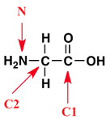
Pharmaceutical Chemistry Questions
What is the hybridisation of the indicated nitrogen atom?
(a) s
(b) sp
(c) sp²
(d) sp³

Slide 41
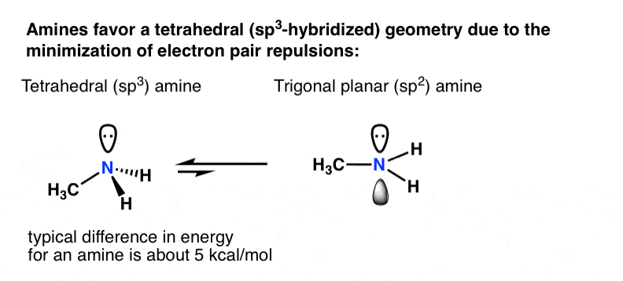
Problem Solving

Slide 42
Answer
What is the hybridisation of the indicated nitrogen atom?
(a) s
(b) sp
(c) sp²
(d) sp³

Slide 43
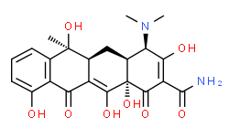
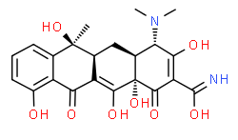
Pharmaceutical Chemistry Questions
The molecules, tetracycline and epi-tetracycline, can be considered to be:
Diastereomers
Drug and pro-drug, respectively
Regioisomers
Equally active
Tetracycline
Epi-tetracycline

Slide 44
Problem Solving
Diastereomers are defined as compounds which have the same molecular formula and sequence of bonded elements but which are nonsuperimposable, non-mirror images
Epimerisation is a process in stereochemistry in which there is a change in the configuration of only one chiral center. As a result, a diastereomer is formed. In acidic conditions around pH 4, tetracycline readily undergoes epimerization at position 4, and an inactive 4-epitetracycline is produced.
Regioisomers are constitutional isomers that have the same functional groups attached at different positions of the molecular backbone.
Epi-tetracycline is not a pro-drug of tetracycline

Slide 45
Answer
The molecules, tetracycline and epi-tetracycline, can be considered to be:
  Diastereomers
  Drug and pro-drug, respectively
  Regioisomers
  Equally active
Epi-tetracycline
Tetracycline

Slide 46
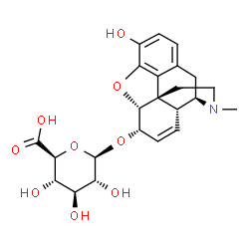
Pharmaceutical Chemistry Questions
  The opioid derivative below is the product of:
  Glucuronidation of codeine at position 3
  Glucuronidation of morphine at position 3
  Glucuronidation of codeine at position 6
  Glucuronidation of morphine at position 6

Slide 47
Answer
  The opioid derivative below is the product of:
  Glucuronidation of codeine at position 3
  Glucuronidation of morphine at position 3
  Glucuronidation of codeine at position 6
  Glucuronidation of morphine at position 6

Slide 48
Pharmaceutical Chemistry Questions
To which pharmacological class does the attached structure belong?
(a) Aminoglycoside
(b) Macrolide
(c) Cephalosporin
(d) Penicillin

Slide 49
Problem Solving
Structure has 4-membered β-lactam ring, therefore penicillin or cephalosporin
Structure has 5-membered thiazolidine ring, therefore cephalosporin
The penicillin skeleton is a fusion of a β-lactam ring to a 6-membered thiazolidine ring
Specific structure is methicillin

Slide 50
Pharmaceutical Chemistry Questions
To which pharmacological class does the attached structure belong?
(a) Aminoglycoside
(b) Macrolide
(c) Cephalosporin
(d) Penicillin

Slide 51
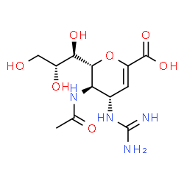
Pharmaceutical Chemistry questions
Zanamivir is used for the treatment of influenza A and B infections. How many stereocentres does the drug molecule possess?
(a) 3
(b) 4
(c) 5
(d) 6

Slide 52
Problem Solving
*
*
*
*
*

Slide 53
Answer
Zanamivir is used for the treatment of influenza A and B infections. How many stereocentres does the drug molecule possess?
(a) 3
(b) 4
(c) 5
(d) 6

Slide 54
Pharmaceutical Chemistry Questions
The molar absorption coefficient of a compound (MW = 300 g/mol) is 2000 M⁻¹ at 254 nm. What will the absorbance of a 0.006% (^{m}/_{v}) solution be at this wavelength?
(a) 0.02
(b) 0.04
(c) 0.2
(d) 0.4

Slide 55
Answer
Beer-Lambert’s Law
A = εbc
0.006% = 0.006 g/100mL = 0.06 g/L
0.06/300g/mol = 0.0002mol/L
A = 2000 x 1cm x 0.0002
A= 0.4

Slide 56
Answer
The molar absorption coefficient of a compound (MW = 300 g/mol) is 10000 M⁻¹ at 254 nm. What will the absorbance of a 0.003% (^{m}/_{v}) solution be at this wavelength?
(a) 0.02
(b) 0.04
(c) 0.2
(d) 0.4

Slide 57
Pharmaceutical chemistry questions
The carbonyl stretch of α, β-unsaturated esters results in an IR band in the region of:
(a) 730 cm⁻¹
(b) 1730 cm⁻¹
(c) 2530 cm⁻¹
(d) 3530 cm⁻¹

Slide 58
Problem Solving
Carbonyl stretching peaks are strong and generally occur between 1800 and 1600 cm ⁻¹
The carbonyl stretch C=O of aliphatic esters appears from 1750-1735 cm⁻¹; that of α, β-unsaturated esters appears from 1730-1715 cm⁻¹.

Slide 59
Answer
The carbonyl stretch of α, β-unsaturated esters results in an IR band in the region of:
(a) 730 cm⁻¹
(b) 1730 cm⁻¹
(c) 2530 cm⁻¹
(d) 3530 cm⁻¹

Slide 60
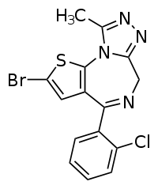
Pharmaceutical Chemistry Questions
What is the pharmacological classification of the attached structure?
(a) Antimicrobial agent
(b) Oncological agent
(c) Cardiovascular agent
(d) Anxiolytic agent

Slide 61
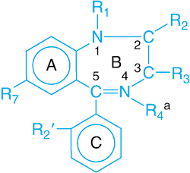
Problem Solving
Structure is a benzodiazepine
The term benzodiazepine refers to the portion of the structure composed of a benzene ring (A) fused to a seven-membered diazepine ring (B).
This specific benzodiazepine is brotizolam

Slide 62
Answer
What is the pharmacological classification of the attached structure?
(a) Antimicrobial agent
(b) Oncological agent
(c) Cardiovascular agent
(d) Anxiolytic agent

Slide 63
Pharmaceutical Chemistry Questions
Which macrolide lacks the C6 hydroxyl group and therefore does not undergo internal ketal formation associated with gastrointestinal cramping?
  Erythromycin
  Lincomycin
  Clarithromycin
  Clindamycin

Slide 64
Problem Solving
The macrolides listed are: erythromycin and clarithromycin
Clarithromycin → the C6 hydroxyl group is converted to a methyl ether → C6 hydroxyl group is essential for inactive ketal formation
Erythromycin
Clarithromycin

Slide 65
Answer
Which macrolide lacks the C6 hydroxyl group and therefore does not undergo internal ketal formation associated with gastrointestinal cramping?
  Erythromycin
  Lincomycin
  Clarithromycin
  Clindamycin

Slide 66
REFERENCE MATERIAL:
PHARMACEUTICAL CHEMISTRY
Drug design and metabolism:
  Drug-like Properties: Concepts, Structure Design and Methods, Elsevier (Academic Press). Authors: Edward H. Kerns and Li Di.
  The Organic Chemistry of Drug Design and Drug Action, latest edition, Elsevier (Academic Press). Author: Richard B. Silverman.
Pharmaceutical analysis:
  Fundamentals of Analytical Chemistry, Latest edition, Brooks/Cole. Authors: Douglas A. Skoog, Donald M. West, F. James Holler, Stanley R. Crouch. (Or similar analytical chemistry text).
Pharmaceutical analysis. A textbook for pharmacy students and pharmaceutical chemists. Elsevier, Churchill Livingstone. Author: David G Watson. (Or similar analytical chemistry text)
Pharmaceutical Calculations. Lippincott, Williams & Wilkins. Authors: Howard C. Ansel, Mitchell J. Stoklosa
Introduction to Pharmaceutical Chemical Analysis, John Wiley & Sons, Ltd; 2011, Authors: S. Hansen, S. Pedersen-Bjergaard, K. Rasmussen K
Organic Chemistry, Latest edition, Brooks/Cole. Author: John E. McMurry. (Or similar organic chemistry text) (Organic chemistry)
Foye's principles of Medicinal Chemistry, Latest edition. Authors: Thomas L. Lemke, David A. Williams, Victoria F. Roche, S. William Zito. (Or similar medicinal chemistry text)
An introduction to Medicinal Chemistry, Latest edition, Oxford. Author: Graham L. Patrick. (Or similar medicinal chemistry text)
Spectrometric Identification of Organic Compounds, Latest edition, Wiley. Authors: Robert M. Silverstein, Francis X. Webster, David Kiemle (Spectroscopy)

Slide 67
Helpful tips
Exam technique
  Select the correct formula.
  Transcribing - Double check against the question that you have used the correct figures in your formula.
  If possible, estimate a range for your answer.
  Always double check your calculation.
Notes:
Examiner / Moderator

Slide 68
Managing time
Maximising your time - 180 minutes
  90 MCQs
  Approximately 2 minutes per question
No negative marking.
Do not leave anything blank.

Slide 69


Time for a 5 minutes break

Slide 70
WEIGHT PER EXIT LEVEL OUTCOME (ELO) PER SUBJECT
Professional exam (300 MCQ) |  | Applied Pharmacology and Toxicology (90 MCQ) | Applied Pharmacy Practice in a Legal Framework (120 MCQ) |  | Applied Pharmaceutics and Pharmaceutical Chemistry (90 MCQ)
ELO | Total | Pharmacology (90 MCQ) | Pharmacy Practice (60 MCQ) | Law and Ethics (60 MCQ) | Pharmaceutics (50 MCQ) | Pharmaceutical Chemistry (40 MCQ)
1 | 12% | 5.55% | 3.33% | 1.66% | 14% | 52.5%
2 | 9.67% | 0 | 0 | 3.33% | 24% | 30%
3 | 6% | 0 | 0 | 13.33% | 20% | 0
4 | 10.33% | 0 | 0 | 10 | 42% | 17.5%
5 | 6.33% | 0 | 15% | 16.67% | 0 | 0
6 | 16% | 30% | 13.33% | 21.67% | 0 | 0
7 | 14.67% | 31.11% | 25% | 1.67% | 0 | 0
8 | 11.67% | 20% | 15% | 13.33% | 0 | 0
9 | 8% | 13.33% | 15% | 5% | 0 | 0
10 | 5.33% | 0 | 13.33% | 13.33% | 0 | 0
11 | 0 | 0 | 0 | 0 | 0 | 0
TOTAL | 100% | 30% | 20% | 20% | 17.0% | 13%

Slide 71
Types of questions: Pharmaceutics
50 questions in total:
Level of cognition
  Knowledge ≤ 10%;
  Application ≥ 50% (case study and scenarios based);
  Problem Solving ≤ 40%

Slide 72
ELO 1
14%
Physical, chemical and biological principles are integrated and applied in the development, formulation, compounding, manufacturing, drug supply management and dispensing of pharmaceutical products.
    Integrating the physical pharmacy aspects such as unit operations, rheology, micrometrics, thermodynamics, solubility, dissolution, stability etc.
    References:
    Martin’s Physical Pharmacy and Pharmaceutical Sciences. Sinko PJ. Latest edition
    The Design and Manufacture of Medicines. Aulton, M.E. Latest Edition

Slide 73
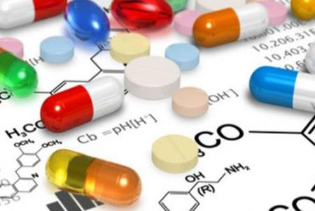
Pharmaceutics questions Examples
Question: The highly soluble amorphous material formed due to quench-cooling of the crystalline drug showed a glass transition temperature of 40 °C. Which of the following would negatively impact the solubility of the amorphous form?
Storing at 40 °C
Storing at 25 °C
Storing it as an amorphous solid dispersion
Mixing with Polyvinylpyrrolidone

Slide 74
Pharmaceutics questions Examples
Question: In the case of water-soluble dyes added to granules prepared with wet granulation technique, which of the following drying equipment would best suit to prevent migration of the colour?
Tray dryer
Spray dryer
Fluidized bed dryer
Microwave Drier

Slide 75
ELO 2
24%
Physicochemical and biopharmaceutical principles are applied in the formulation and development of pharmaceutical products.
Physical, chemical and biological principles are applied in the manufacturing, compounding and quality assurance of pharmaceutical products.
Physicochemical and biopharmaceutical principles are applied in compounding and dispensing of pharmaceutical products.
    Biopharmaceutical factors in formulation design, its effect on the drug bioavailability.
    Application of pharmacokinetics in clinical situations.
    Novel drug delivery systems (GRDDS, Colon, Nasal, including the vesicular drig delivery systems)
    References:
        Applied Biopharmaceutics and Pharmacokinetics: Shargel L and Yu S.A. Latest edition.
        Drug Delivery & Targeting. Perrie Y and Rades T. Latest edition

Slide 76
Pharmaceutics questions Examples
Question: Which of the following age-related factors can significantly affect pharmacokinetics among elderly patients that would lead to dose adjustments?
Increase in total body water
Decrease in body fat
Decrease in serum albumin concentrations
Decrease in creatinine clearance

Slide 77
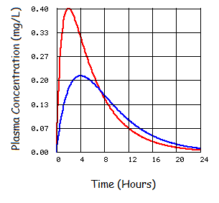
Pharmaceutics questions Examples
Question: The figure below shows the plasma concentration time profiles of the weakly acidic drug X (pKa of 4.0), administered orally as a tablet under fasting (pH 1.2) and fed conditions (pH = 4). Which of the following statement is correct pertaining to the absorption of the drug?
The rate of absorption is always faster in the fasting conditions compared to the fed conditions
The drug taken under fasting condition resulted 100% ionisation, leading to greater Cmax
The change in pH of fed conditions resulting in 50% of unionized form the drug, leading less Cmax
The extent of absorption is same under both fasting and fed conditions
Henderson–Hasselbalch equation

Slide 78
Pharmaceutics questions Examples
Question: If the bioavailability of sildenafil citrate in a 50 mg tablet is 0.25 compared to the bioavailability of 0.75 in a sildenafil citrate simple syrup (1 mg/mL), calculate the dose of the syrup equivalent to the tablet.
3 ml
16.7 ml
26.6 ml
66.6 ml

Slide 79
Pharmaceutics questions Examples
Amount of sildenafil citrate bioavailable from the tablet = 50 mg x 0.25 = 12.5 mg,
Amount of ‘sildenafil citrate bioavailable from the syrup = 0.75 x 1 mg/ml = 0.75 mg/ml
Quantity of syrup that will provide 12.5 mg of ‘‘bioavailable’’ sildenafil citrate =
12.5 mg/0.75 mg = 16.7 ml

Slide 80
ELO 3
20%
Pharmaceutical preparations are compounded in accordance with GMP.
Sterile admixtures are produced in accordance with aseptic techniques and principles of GMP and GPP.
      Application of GMP principles in compounding and manufacturing (The 5P’s, validation & qualification, cross-contamination, audits, product recalls).
      Look at the sterilization techniques, formulation of sterile pharmaceutical products such as small and large volume parenteral, ophthalmic, nasal sterile formulations and Isotonicity adjustments. Also, clean room requirements.
      References:
          The Design and Manufacture of Medicines. Aulton, M.E. Latest Edition,
          Pharmaceutical Practice: Winfield AJ and Richards RME. Latest edition.
          GMP guidelines (SA Guide to GMP)

Slide 81
Pharmaceutics questions Examples
Question: According to Good Manufacturing Practice, sliding doors may be undesirable in clean room because they:
are difficult to open and close under pressure
are very expensive to maintain
may have uncleanable recesses
cannot handle pressure differentials

Slide 82
Pharmaceutics questions Examples
Question: Good manufacturing practice (GMP) requires that materials and products, should be stored accordingly to avoid contamination, mix-up’s and instability. Which of the following statement(s) is/ are TRUE pertaining to storage conditions used?
Intermediates of effervescent product should be stored at 25 °C and 50% RH
Rejected materials should be stored in a lockable cage
Starting materials can be stored with intermediate products as long as the temperature and humidity conditions are maintained
Finished products can be stored in passage as long as they are shrink wrapped to avoid mix-up’s

Slide 83
Pharmaceutics questions Examples
Question: Which of the following parameters needs to be optimized during the process validation of a tablet dosage form manufactured by wet granulation?
Quantity of the diluent
Storage conditions of the finished product
Container and closure system
Loss on drying

Slide 84
Pharmaceutics questions Examples
Which the following excipient is not advised to use in the formulation of large volume parenteral product?
Cyclodextrin
Benzothonium chloride
Dextrose
Sodium acetate

Slide 85
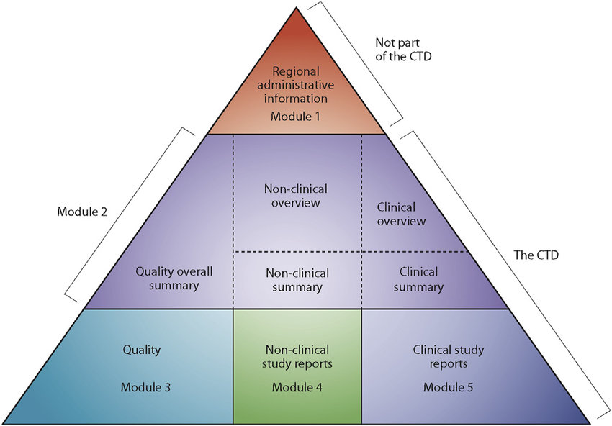
ELO 4:
42%
Medicines registration dossiers for pharmaceutical products using the supplied data and documentation are compiled in accordance with the current relevant legislation.
Understand CTD with emphasis on Quality aspects of API and FPP
guidelines such as stability,
dissolution,
post registration amendments
impurity profiles

Slide 86
Pharmaceutics questions Examples
Question: How many pilot scale batches should be considered for stability testing of codeine tablets?
At least 2
At least 1
At least 3
At least 4

Slide 87
Pharmaceutics questions Examples
Question: PTA pharmaceuticals decided to use a fluidized bed dryer as the tray dryer method was taking too long to complete the manufacturing of paracetamol tablets. Which of the following minimum data is required for submission to the South African Health Products Regulatory Authority (SAHPRA) for the approval of post registration changes?
Moisture content and Type A dissolution
Moisture content, Type A dissolution and stability
Type A dissolution, stability and process validation
Type A dissolution and stability

Slide 88
Pharmaceutics questions Examples
Question: PTA pharmaceuticals decided to substitute an Active Pharmaceutical Ingredient (API) of a multi-active tablet dosage form by a different salt from the API, where the efficacy/safety characteristics are not significantly different. Which of the following variation type allocation should be submitted to regulatory authorities prior to marketing?
Type IA variation
Type IB variation
Type II variation
Extension applications

Slide 89
ELO 4:
42%
Master production documentation for the manufacture of pharmaceutical products is interpreted in terms of GMP.
The GMP requirements for generation and reconciliation of batch manufacturing documents are described.
    Understand the importance and elements of SOPs, COA, Specifications, Site master file, Validation master plan, logbooks, Batch manufacturing and packing documents.
    Ref: SA guide to GMP guidelines, available from https://www.sahpra.org.za

Slide 90
Pharmaceutics questions Examples
Question: Which of the following would NOT form part of a Site Master File for a specific manufacturing site?
Organizational charts
Reports of finished product analysis
Details of starting material suppliers
Qualifications, experience and responsibilities of key personnel

Slide 91
Pharmaceutics questions Examples
Question: Which statement is true of the following regarding documentation in pharmaceutical manufacturing facility?
Batch records give direction for performing certain operations e.g. cleaning
Can be completed after the manufacturing process is completed
Packaging instructions should include details of in-process controls with instructions for sampling and acceptance limits
Log books are not needed when products are manufactured using dedicated equipment

Slide 92
ELO 4:
42%
Dosage forms are manufactured on a laboratory scale according to plan and standard operating procedures.
    Understand the dosage form design and formulation aspects, with emphasis on the functions of excipients, manufacturing methods, equipment used and quality control procedures.
    References:
          The Design and Manufacture of Medicines. Aulton, M.E. Latest Edition,
          Pharmaceutical Practice: Winfield AJ and Richards RME. Latest edition.

Slide 93
Pharmaceutics questions Examples
Question: Which of the following is a disadvantage of glycerol-gelatin base when used in the formulation of suppositories?
Produce a laxative effect
Become brittle when cooled rapidly
Produce different polymorphic forms when cooled rapidly
Has got poor water absorbing ability

Slide 94
Pharmaceutics questions Examples
Question: Capping of the tablet can be eliminated by:
pre-compression
increasing the final compression rate
using Concave punches
increasing the moisture content of granules through addition of water

Slide 95
Pharmaceutics questions Examples
Question: Durability of a tablet to combined effects of shock & abrasion is evaluated by using:
a) Hardness tester
b) Disintegration test apparatus
c) Friabilator
d) Screw guage

Slide 96
Pharmaceutical calculations
Dilutions – Alligation method
Concentrations - Percentage, Ratio Strength etc.
Upscaling, down scaling of master Formula.
Yield calculations
Potency calculations
Density / Specific gravity
Displacement Values – e.g. Suppositories compounding
Molecular Weights and Moles
Parenteral Solutions / Isotonicity –NaCl equivalent and Freezing point depression
Dosage calculations
Shelf-life calculations – orders of reaction
HLB calculations
Reference: Pharmaceutical Calculations. Ansel HC and Stockton SJ. Latest edition

Slide 97
Pharmaceutics questions Examples
Calculate how many grams of sodium chloride should be added to 50 ml of a 0.5% w/v solution of lignocaine hydrochloride to make a solution iso-osmotic with blood serum. Freezing point depression of Sodium chloride and Lignocaine hydrochloride at a concentration of 0.5% w/v are 0.288 and 0.0625 respectively.
0.397 g
0.794 g
0.849 g
1.697 g

Slide 98
Pharmaceutics questions Examples
W = (0.52 – a)/b
= 0.52 – (0.5 x 0.125)/0.576
= 0.794 % w/v
0.794 g in 100 ml
X g in 50 ml
X = (0.794 x 50)/100
X = 0.397
0.397 g of sodium chloride required
Understand Colligative properties. Also check the other methods such as sodium chloride equivalent method.

Slide 99
Pharmaceutics questions Examples
The following data represents the decomposition of a drug XYZ. If the rate of reaction is independent of the concentration, determine the rate constant at which the drug is decomposing.
0.000067 mg.sec⁻¹
0.001500 sec⁻¹
0.031746 mg⁻¹.sec⁻¹
0.031746 mg.sec⁻¹
TIME (sec) | Concentration (mg)
0 | 0.050
60 | 0.046
120 | 0.042
180 | 0.038
300 | 0.030
420 | 0.022

Slide 100
Note: Use one of the following equations to calculate the rate constant to six decimal points.
C = -k₀t + C₀
Ln C = ln C₀ - kt or Log C = - k t + log C₀
2.303
1 = 1 + kt
C C_{o}
t₉₀ = 0.1 C₀
k₀

Slide 101
C = -k t + C₀
0.042 = - k x 120 + 0.050
k = 0.050- 0.042/120 = 0.000067 mol.L⁻¹.sec⁻¹

Slide 102
REFERENCE MATERIAL:
PHARMACEUTICS
Martin’s Physical Pharmacy and Pharmaceutical Sciences: Sinko PJ. Latest edition
Pharmaceutics: The Design and Manufacture of Medicines: Aulton, M.E. Latest Edition
Pharmaceutical Calculations: Ansel HC and Stockton SJ. Latest edition
Pharmaceutical Practice: Winfield AJ and Richards RME. Latest edition.
Applied Biopharmaceutics and Pharmacokinetics: Shargel L and Yu S.A. Latest edition.
Hugo and Russels Pharmaceutical Microbiology: Denyer S.P., Hodges N, Gorman S.P. Latest edition.
GMP guidelines, P & A guidelines – e.g. Stability guidelines, and Bioavailability guidelines available from https://www.sahpra.org.za
Pharmaceutics: Drug Delivery & Targeting. Perrie Y and Rades T. Latest edition

Slide 103
WEIGHT PER EXIT LEVEL OUTCOME (ELO) PER SUBJECT
Professional exam (300 MCQ) |  | Applied Pharmacology and Toxicology (90 MCQ) | Applied Pharmacy Practice in a Legal Framework (120 MCQ) |  | Applied Pharmaceutics and Pharmaceutical Chemistry (90 MCQ)
ELO | Total | Pharmacology (90 MCQ) | Pharmacy Practice (60 MCQ) | Law and Ethics (60 MCQ) | Pharmaceutics (50 MCQ) | Pharmaceutical Chemistry (40 MCQ)
1 | 12% | 5.55% | 3.33% | 1.66% | 14% | 52.5%
2 | 9.67% | 0 | 0 | 3.33% | 24% | 30%
3 | 6% | 0 | 0 | 13.33% | 20% | 0
4 | 10.33% | 0 | 0 | 10 | 42% | 17.5%
5 | 6.33% | 0 | 15% | 16.67% | 0 | 0
6 | 16% | 30% | 13.33% | 21.67% | 0 | 0
7 | 14.67% | 31.11% | 25% | 1.67% | 0 | 0
8 | 11.67% | 20% | 15% | 13.33% | 0 | 0
9 | 8% | 13.33% | 15% | 5% | 0 | 0
10 | 5.33% | 0 | 13.33% | 13.33% | 0 | 0
11 | 0 | 0 | 0 | 0 | 0 | 0
TOTAL | 100% | 30% | 20% | 20% | 17.0% | 13%

Slide 104
Types of questions: Pharmacology
90 questions in total:
level of cognition
  Knowledge ≤ 10%;
  Application ≥ 20% (case study based and scenarios);
  Problem Solving ≤ 70% 3 hours

Slide 105
REFERENCE MATERIAL: APPLIED PHARMACOLOGY & TOXICOLOGY
Basic and Clinical Pharmacology. Latest Edition. Katzung, Masters and Trevor
Pharmacology. Latest Edition. Rang, H.P., Dale, M.M. & Ritter, J.M., Churchill Livingstone, Edinburgh.
Pharmacology. Latest Edition. Mycek, M.J., Harvey, R.A., & Champe, P.C., (Part of Lippincott’s Illustrated Review Series), Lippincott-Raven, Philadelphia. (ISBN 0- 397-51567-79)
Goodman and Gilman’s: The Pharmacological Basis of Therapeutics; Latest Edition. Brunton, Lazo and Parker
Pharmacotherapy: A Pathophysiologic Approach. Latest Edition. DiPro, R.L., Talbert, P.E., Yee, G.C., Matzke, G.R., Posey, L.M., Appelton & Lange, Norwalk, Connecticut, (ISBN 0-8385-7976-0)
South African Medicines Formulary (SAMF). Latest edition
South African Clinical Guidelines for various conditions e.g. South African Hypertension Practice Guideline
South African Essential Medicines Lists and Standard Treatment Guidelines:
  Paediatric Hospital Level STGS and EML_4th Ed 2017 – final. Available at: http://www.health.gov.za/index.php/standard-treatment-guidelines-and-essential-medicineslist
  Hospital level (Adult) 2015_v5.0. Available at: http://www.health.gov.za/index.php/standardtreatment-guidelines-and-essential-medicines-list/category/286-hospital-level-adults
  Primary Healthcare level 2014. Available at: http://www.health.gov.za/index.php/standard-treatment-guidelines-and-essential-medicines-list/category/285-phc#

Slide 106
Helpful tips
NB!
  “TRUE”, “IS” and “CORRECT”
  “EXCEPT”, “FALSE”, “NOT” and “INCORRECT”
  “MOST APPROPRIATE” implies that more than one answer is possible, thus select the most inclusive answer
  READ the question carefully.
  IDENTIFY the statements of which you are sure.
  CONFIRM (using references) the statements you are unsure of.
  CARRY ON if you can’t complete the question, and when you have time towards the end of the exam come back to it.
Notes:
Examiner / Moderator

Slide 107
Managing time
Maximising your time - 180 minutes
  90 MCQs
  Approximately 2 minutes per question
No negative marking.
Do not leave anything blank.

Slide 108
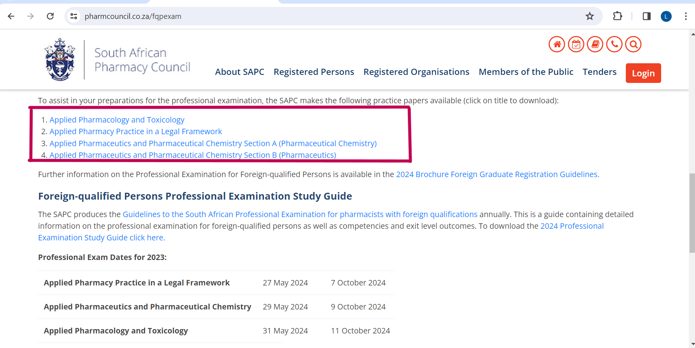
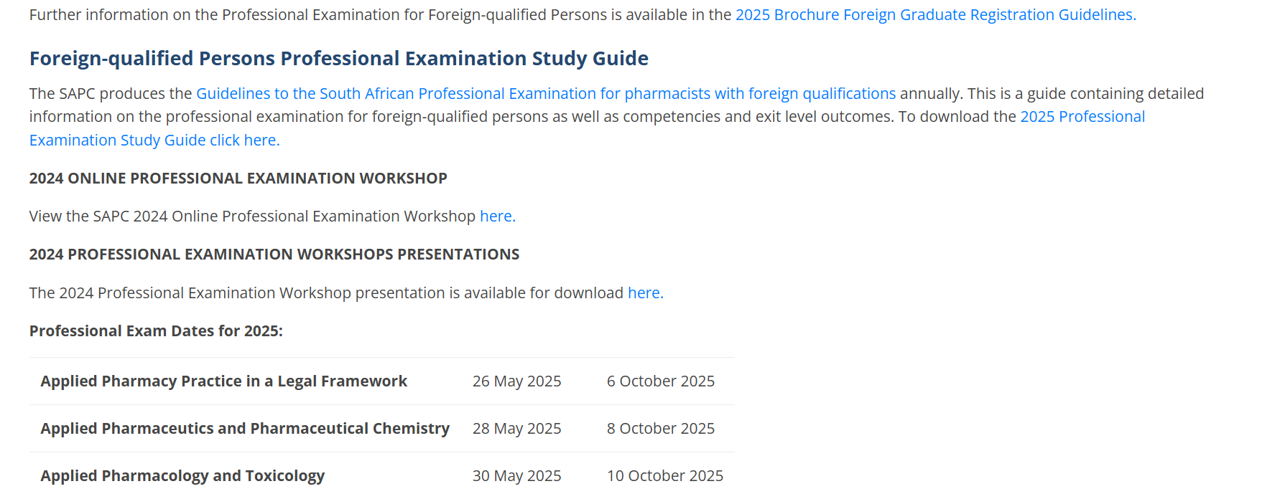
Examination examples
https://sapc.za.org/fqpexam

Slide 109

TIPS FOR PREPARATIONS
Use the latest reference material.
Check the current events (pandemics/epidemics) locally / globally.
Keep abreast with the latest developments / information.
Familiarise yourself with each reference material (index/topic).
Use reference material that you have used before.
Understand the SA work environment (SOPs).

Slide 110
Preparing for the examination
Update your details on your SAPC profile.
  Cell phone number
  Email address
  Profile picture
You are notified via email and SMS when bookings are open.
IMPORTANT DATES
Applied Pharmacy Practice in a Legal Framework | 26 May 2025
Applied Pharmaceutics and Pharmaceutical Chemistry Applied Pharmacology and Toxicology | 28 May 2025 30 May 2025
Notes:
R1 113.00 Late booking fee

Slide 111
Remote online examination

Slide 112
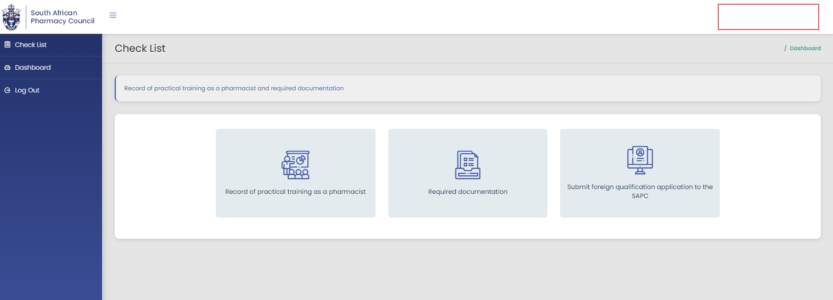
Examination booking

Slide 113
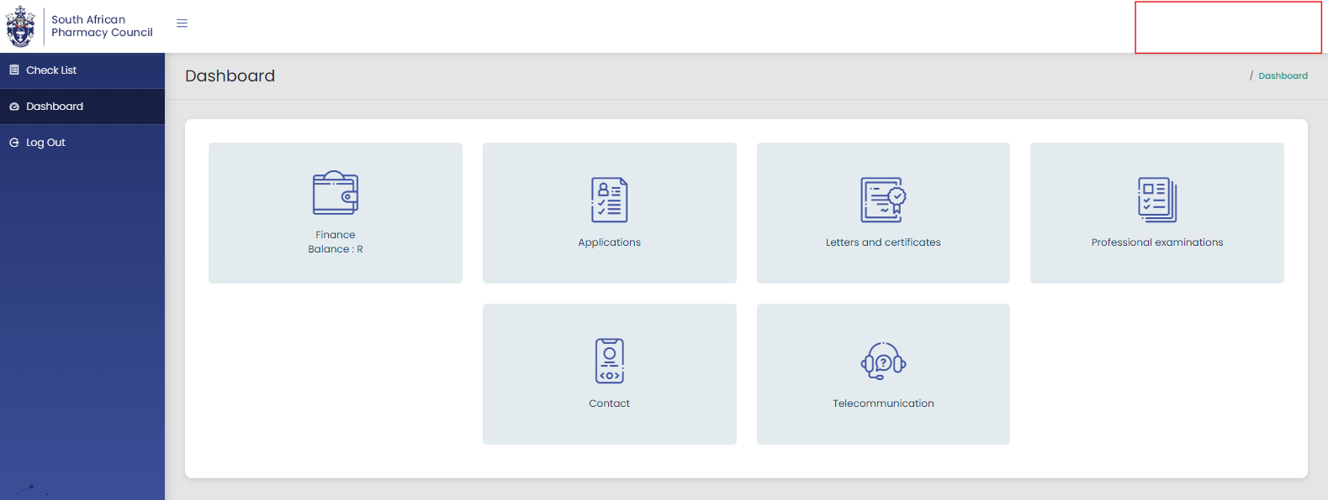
Examination booking (cont.)

Slide 114
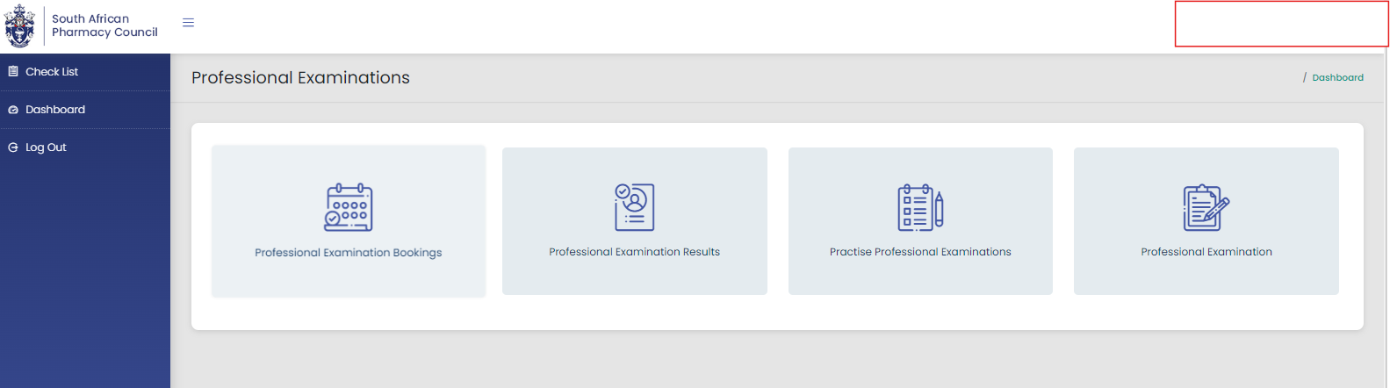
Examination booking (cont.)

Slide 115
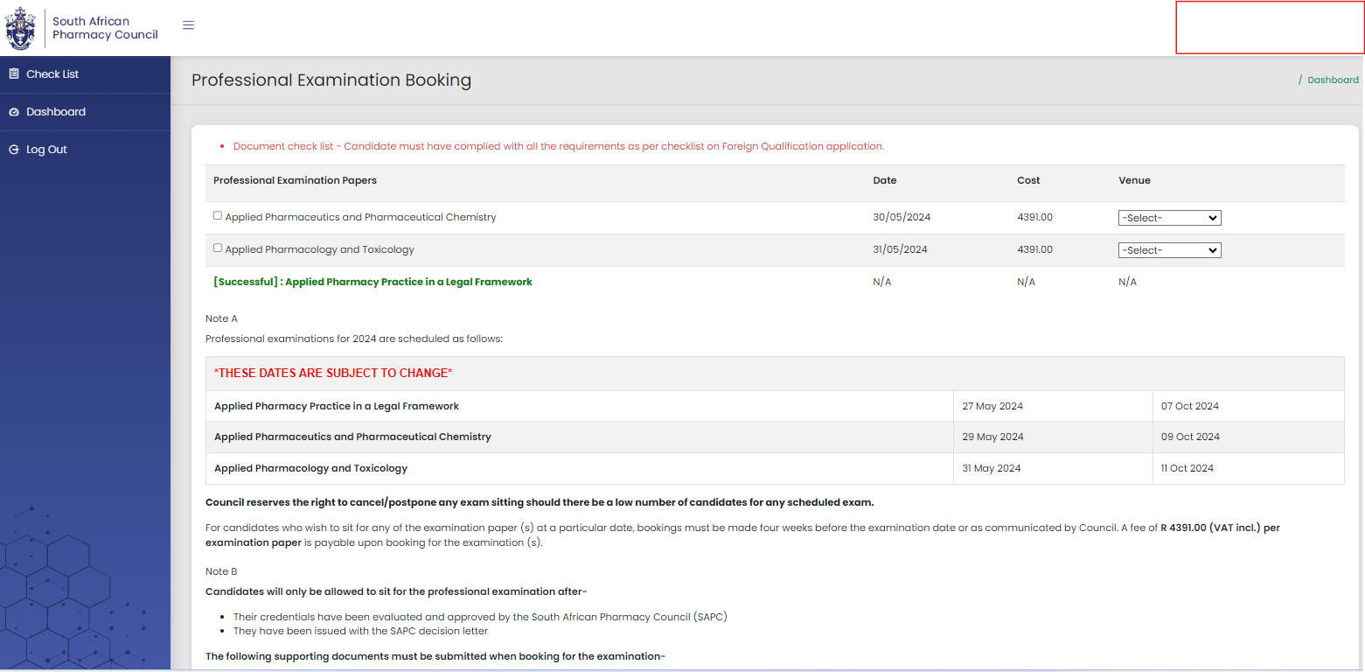
Examination booking (cont.)

Slide 116

Remote online examination
RESIDENCE
SAPC
WORKPLACE
OTHER
VENUES FOR THE ASSESSMENT

Slide 117






Remote online examination
Find a quiet suitable workplace with
enough space for device and references.
Keep calm.
Communicate with your remote invigilator if you are experiencing any difficulty.
Download electronic references before the examination date.
Ensure you have the equipment you will need
i.e. calculator, paper for working out calculations.
Notes:
SAPC

Slide 118








Device and connectivity for candidates
SUGGESTED
DEVICES:
OR
AND
DEVICE MUST HAVE A CAMERA OR A LINKED CAMERA WITH VIDEO CAPABILITIES
CONNECTIVITY (MINIMUM 3G)
BROWSERS

Slide 119



Profile picture
Image uploaded on SAPC needs to be:
a colour image,
taken in last 6 months,
of your head and shoulders
PLEASE NOTE:
Profile picture is used by the invigilator to verify the identity of the candidate writing the exam

Slide 120
Day of the examination
08h00
Login to the SAPC website & enter a one-time pin (cell phone) to enter the examination
  Complete the declaration
  Read the examination rules
Examination commences (remote invigilator)
  Live invigilation through video streaming. Images taken to verify learner (periodically images will be taken throughout the exam)
Examination ends
09h00
13h00

Slide 121
STEPS TO LOGIN AND ACCESS THE EXAMINATION PLATFORM ON THE SAPC WEBSITE

Slide 122
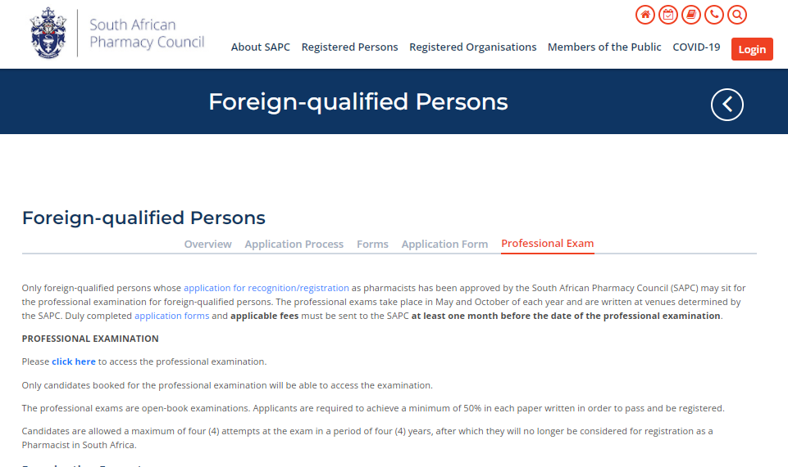
ACCESSING THE EXAMINATION PLATFORM
The examination can be accessed on the SAPC website under Quick Links→ Foreign-qualified Persons → Professional Examination → Click on the link “Click here” to access the Professional Examination. Alternatively use the below URL to connect:
https://sapc.za.org/fqpexam

Slide 123
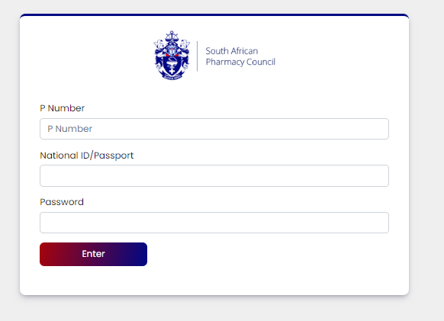
Step 2: Insert your login credentials

Slide 124

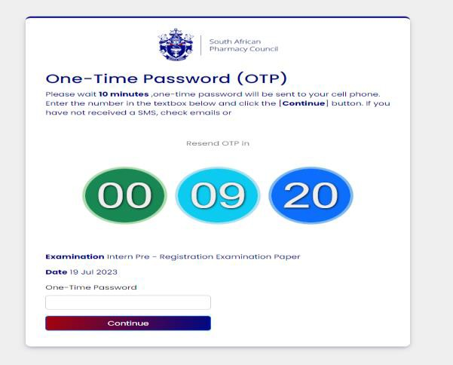
Step 3: Insert your OTP
The OTP will be sent as an SMS to your cell phone and via Email, and will be valid for 10 minutes, if unused. A new OTP will be generated for each login.

Slide 125
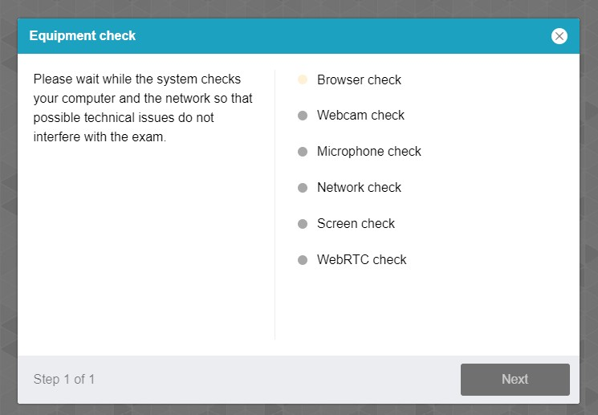
Step 4: Equipment check
The examination platform will conduct an equipment check to ensure your device is compatible to the examination platform.
Use the following link: https://proctoredu.com/check to test the compatibility of your laptop/desktop.

Slide 126
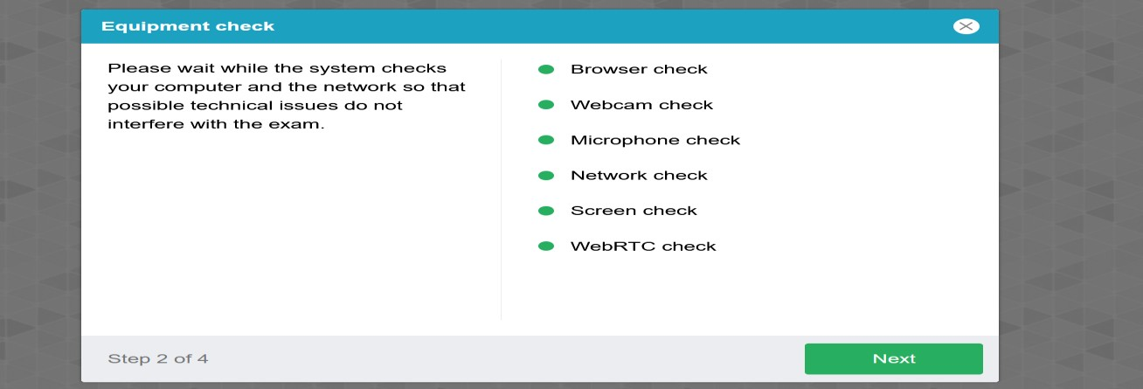
Step 5: Equipment check successfully completed

Slide 127
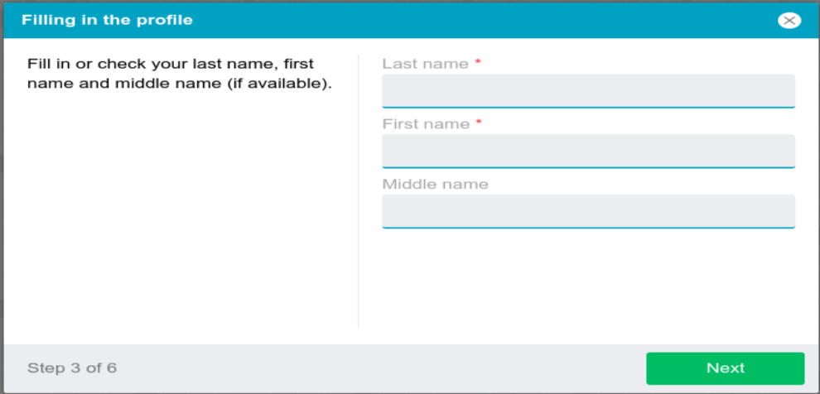
Step 6: Profile check
Click on NEXT when profile check is completed.

Slide 128
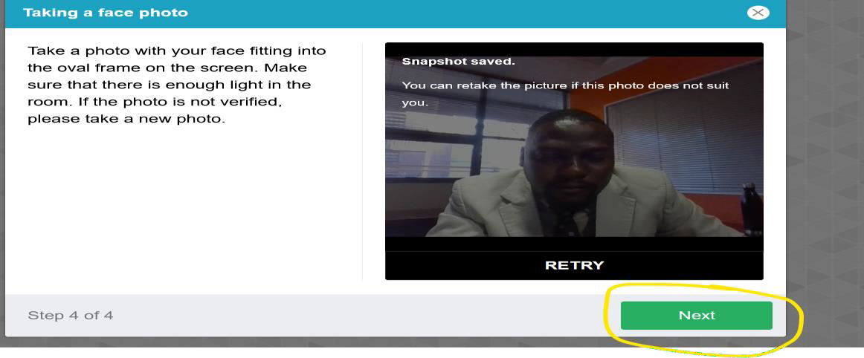
Step 7: verification of the picture
Click on NEXT if satisfied with the photo

Slide 129
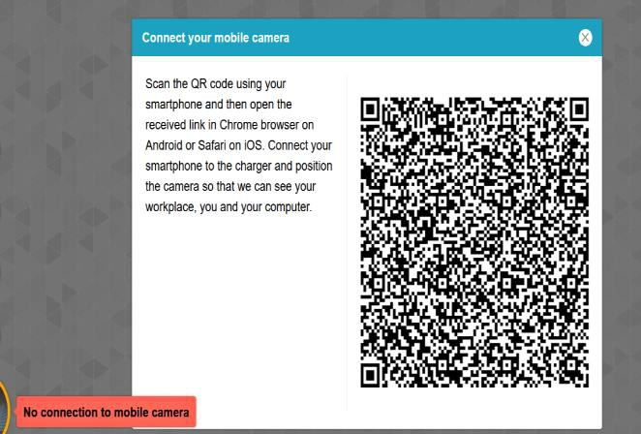
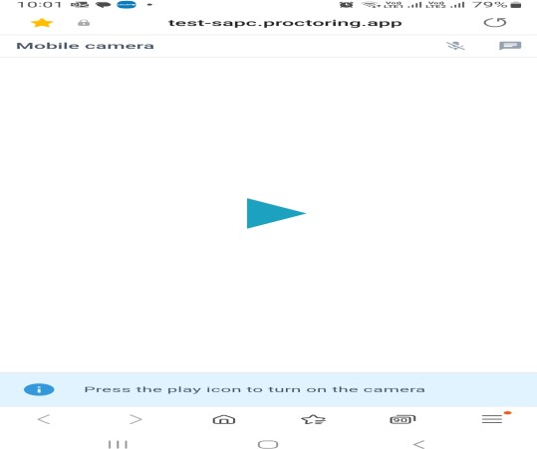
Step 8: Scanning of the QR code
Use a smartphone to scan the QR code to connect the phone to the examination platform for a better view of your workspace and examination room. Click on the play button to record a short video of your room surroundings.

Slide 130
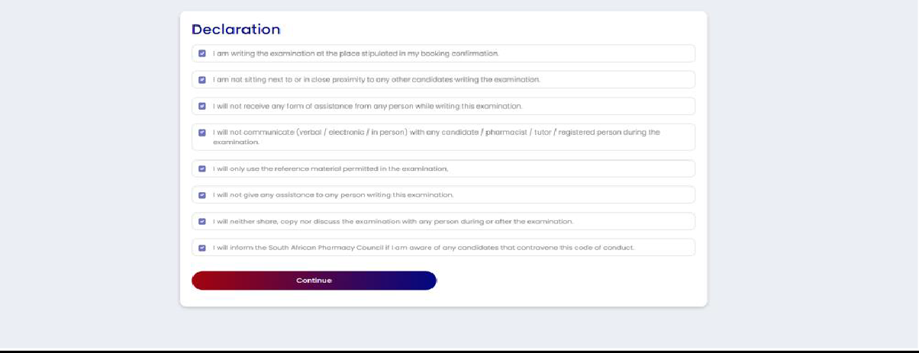
Step 9: Complete the examination declaration

Slide 131
DECLARATION FOR THE ONLINE/REMOTE PROFESSIONAL EXAMINATIONS
PRIOR TO START OF EXAMINATION
I hereby declare that I am the candidate registered to write the pre-registration examination on the _______________and agree to abide by the Examination Code of Conduct:
I am completing the examination in a suitable area with minimal anticipated distractions.
I am completing the examination at the location/place stipulated in my booking confirmation.
I have procured the minimum required data for the purpose of the examination, which is equivalent to 3Gb per paper.
I am not sitting next to or in close proximity to any other candidate completing this examination.
I will not receive any form of assistance from any person while writing this examination.
I will not communicate (verbal / electronic / in person) with any registered person during the examination.
I will only use the reference material permitted in the examination.
I will not access any other reference material that has been prohibited including websites.
I will not give any assistance to any person completing this examination.
I will not share or retain the contents of the examination via electronic, printed, written or verbal means with any person.
I will inform the South African Pharmacy Council if I am aware of any candidate that contravenes the Examination Code of Conduct.
Notes:
SAPC

Slide 132
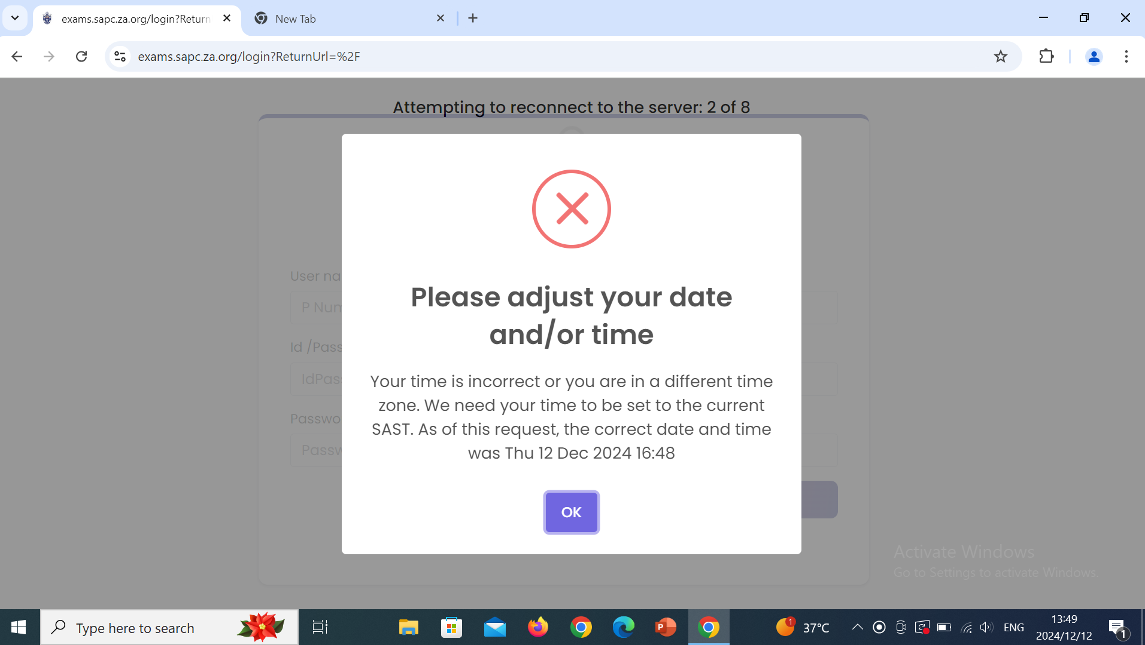
Important messages to take note of:
Region: South Africa
Time zone: Harare, Pretoria
Turn “off” the “set the time zone automatically”

Slide 133
DECLARATION FOR THE ONLINE/REMOTE PROFESSIONAL EXAMINATIONS
END OF EXAMINATION
I confirm that I have completed the examination without assistance from any person and adhered to the Examination Code of Conduct. I understand that if it is found that I have contravened the Examination Code of Conduct, the SAPC will implement disciplinary action against me in terms of Chapter V of the Pharmacy Act.
I will not/ have not shared or retained the contents of the examination via electronic, printed, written or verbal means with any person.
Notes:
SAPC

Slide 134
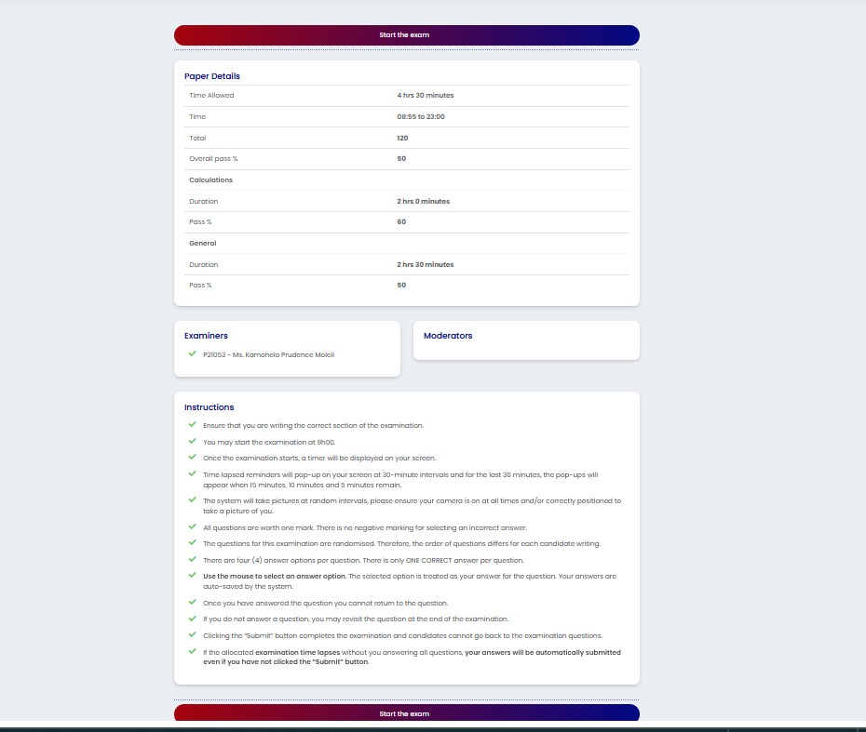
Step 10: Read the examination instructions
Only click on “start the examination” at 09h00 when the examination is schedule to start. SAPC will communicate if there are any delays in starting the examination.

Slide 135

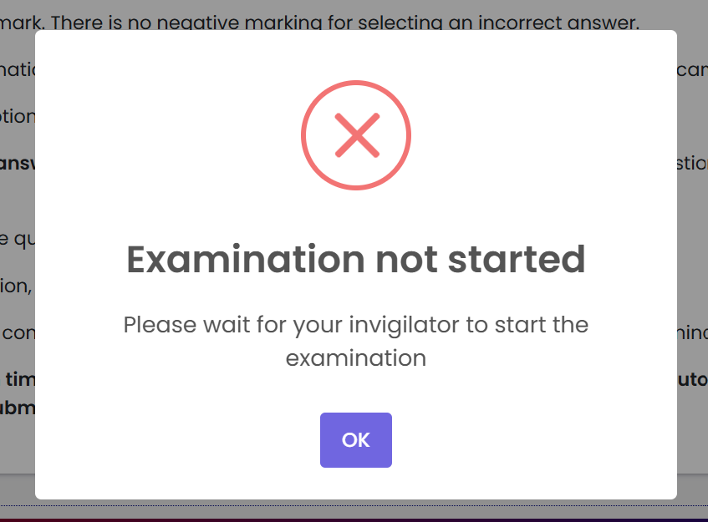
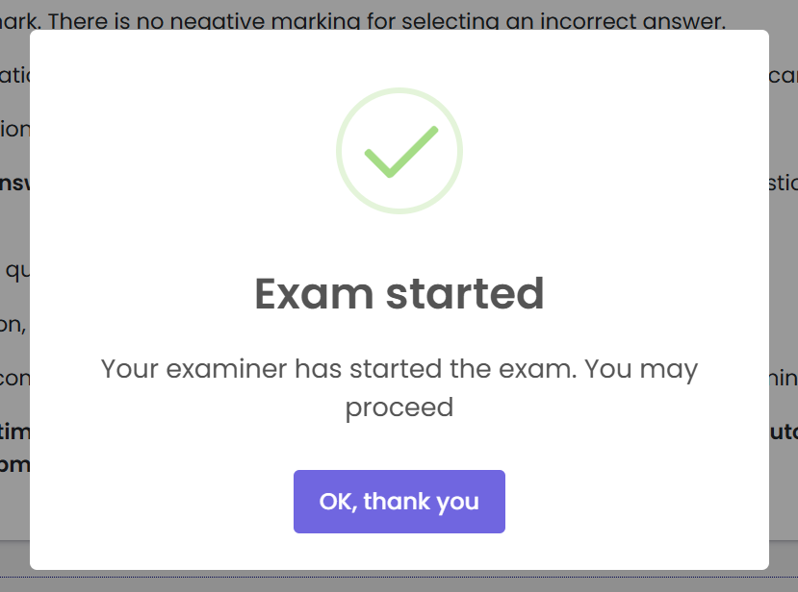
Important messages to take note of:

Slide 136
Examination format
ONE QUESTION PER PAGE
  Cannot select which questions to answer first.
RANDOMISATION OF QUESTIONS
TIMED EXAMINATION
CANNOT REVISIT ANY QUESTION THAT HAS BEEN ANSWERED
UNANSWERED QUESTIONS MAY BE REVISITED AT THE END OF THE EXAMINATION
Notes:
SAPC

Slide 137
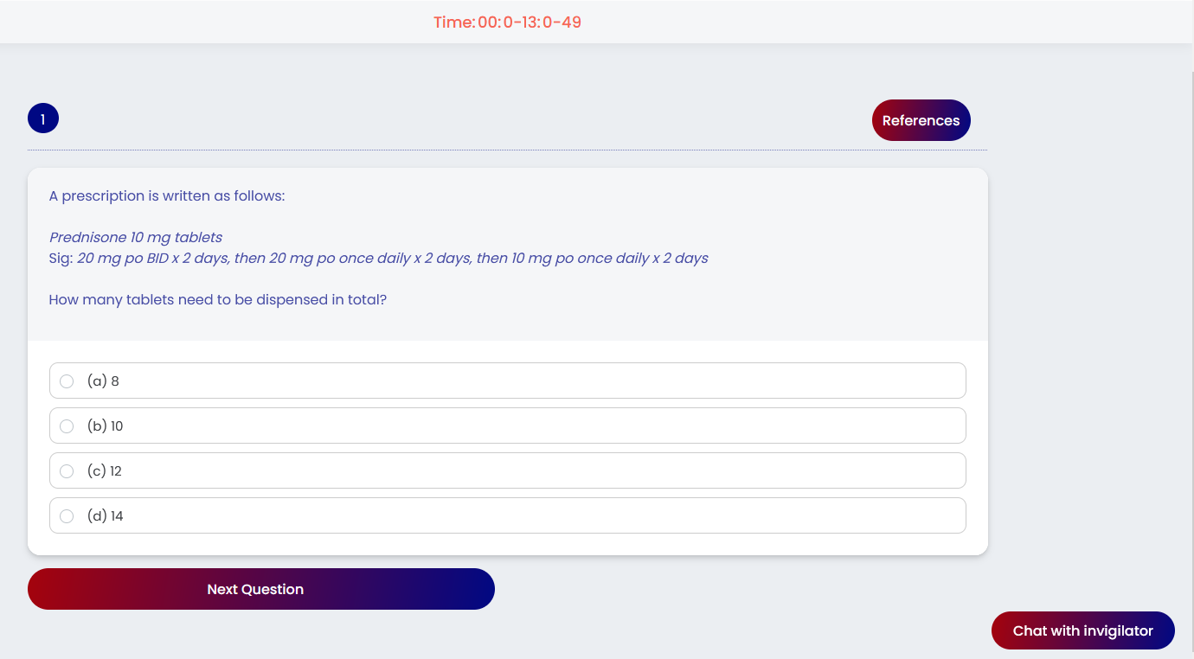
Single best answer
Multiple choice questions
QUESTION
OPTIONS
ANSWER
Notes:
SAPC

Slide 138

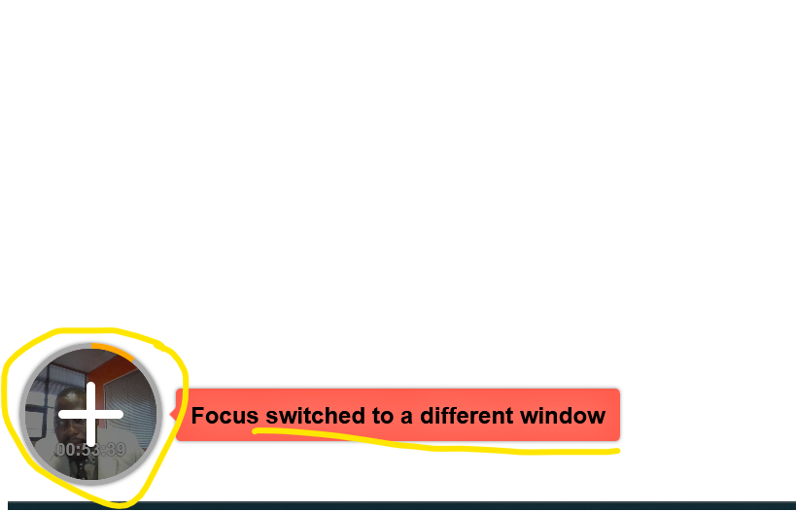

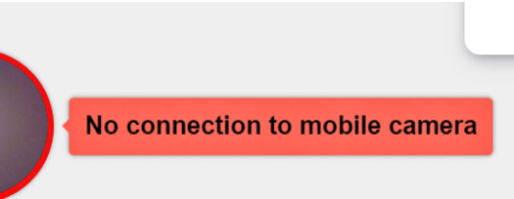

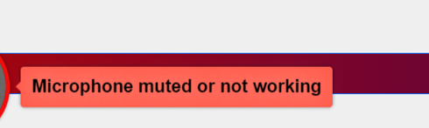
VIOLATION DURING EXAMINATION
Any action undertaken by the candidate to gain unfair academic advantage.
This may include cheating/copying and possession of unauthorised materials
Google to access approved online reference material
Notes:
Violation is the act of breaching the exam disciplines and this slide shows the messages that may pop up when violations are suspected. If you engage in any misconduct during the exam, you may be dismissed
Outside the accessing approved online reference material

Slide 139

FAQs
Where can I get help?
Chat function
  Type your question in the chat function.
  Your invigilator will respond via the chat.
WhatsApp
  Send a message to the invigilator on WhatsApp.
  Keep calm, the invigilator will respond to your message (give him/her a few minutes to respond).
Notes:
SAPC

Slide 140
FAQs
What if the invigilator needs to contact me?
Keep your cell phone next to you, ensure that it is fully charged and you have data.
The invigilator may call or send you a message on the cell phone number you have provided to SAPC.

Slide 141

FAQs
What should I do if my invigilator notifies me that they cannot see me during the exam?
Scan the QR code again to ensure your smartphone is connected to the exam platform.

Slide 142
FAQs
What to do if you experience load shedding / loss in electricity?
Keep calm
Check your load shedding schedule and make an alternative plan.
Ensure laptop is fully charged before the examination.
Ensure alternative WiFi connection is available (if you are using a fibre connection).
If you are unable to find an alternate WiFi connection or if you need to be connected to power supply, please find an alternative place. NB Notify us via the WhatsApp number.
If load shedding happens in the middle of the exam, your work will be saved.
Notes:
SAPC

Slide 143
FAQs
What happens to the questions you have answered if you lose connection?
Keep calm.
All questions are saved as you answer them.
When you log on again you will only have access to questions you have not yet answered.
The questions will be randomized, and they may renumber (starting at 1). Continue to answer the questions as they appear.
Notes:
SAPC

Slide 144
FAQs
What should I do if disconnected and on login back a pop-up message “ This page was opened elsewhere”?
Close all browsers to login again.

Slide 145
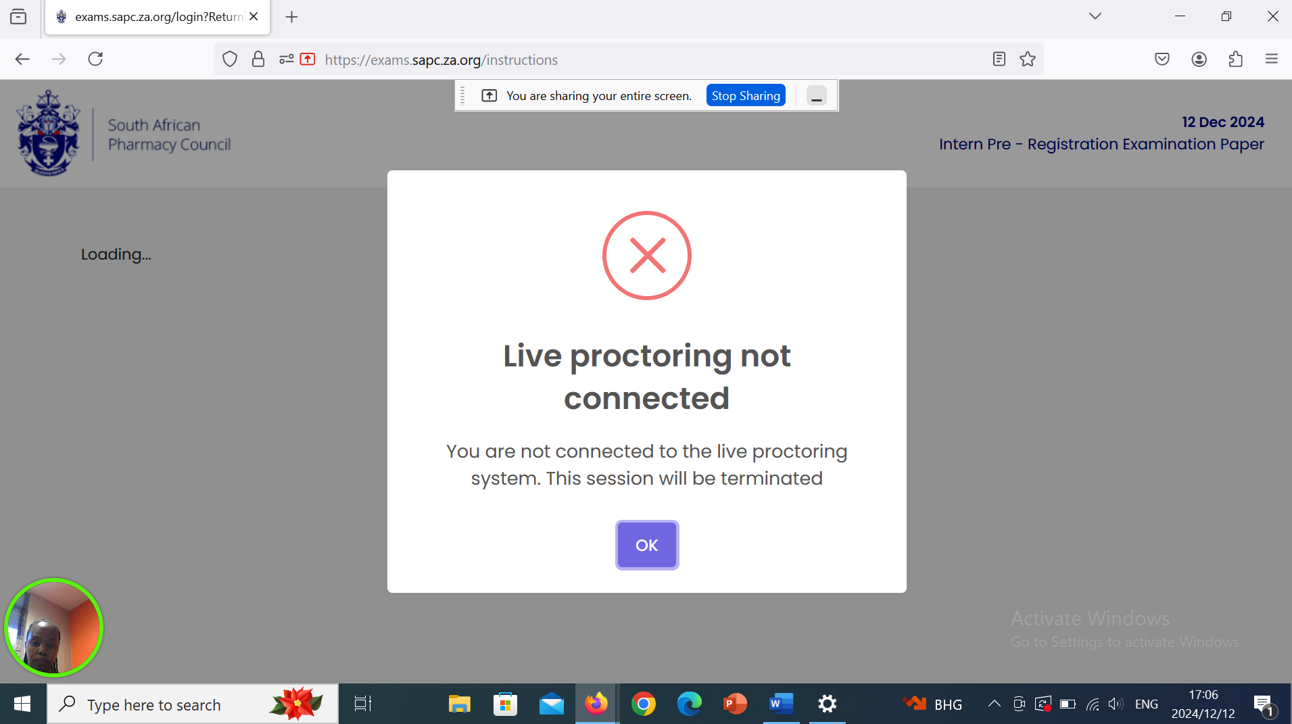
Important messages to take note of:

Slide 146
FAQs:
Steps for clearing the cache/troubleshooting
Clear Cache on Google Chrome
Step 1: Open Google Chrome and click on the 3 dots on the far right
Step 2: Go to settings
Step 3: Click on Privacy and Security
Step 4: Click on the Delete browsing data
Step 5: Select the time range (Recommended: last 24 hours), and click on delete. Restart the close and open Google Chrome, and try again.
Google chrome incognito mode
Step 1: Click the 3 dots
Step 2: Click on New Incognito window
Step 3: Access the exam

Slide 147
FAQs:
Steps for clearing the cache/troubleshooting
Firefox clear cache:
Step 1: click on the 3 lines
Step 2: Click on Settings
Step 3: Click on Privacy and Security
Step 4: Scroll down and select Clear Data
Step 5: Choose a time range (Recommended everything) and click clear
Firefox Private window:
Step 1: Click on the 3 lines
Step 2: CLick New private window
Step 3: Access the exam in private tab as new session.

Slide 148
FAQs:
Steps for clearing the cache/troubleshooting
Microsoft Edge Clear Cache:
Step 1: Click on the 3 dots
Step 2: Click on Settings
Step 3: Click on the 3 lines
Step 4: Click on privacy, search and services
Step 5: Scroll down and click on choose what to clear
Step 6: Choose a time range and click on clear
Microsoft Edge Inprivate window
Step 1: Click on the 3 dots
Step 2: Clcik on the New InPrivate window
Step 3: Access the exam inprivate

Slide 149
Where you sit is IMPORTANT!
Images are taken of the candidate throughout the exam.
Ensure there is sufficient lighting (for example close curtains or blinds if sitting in front of a window).
Test the lighting beforehand (take a selfie of yourself).
Ensure your camera is on.
Dress appropriately – images taken form part of your permanent record.
If the invigilator cannot see the images taken, they will phone you on your cell phone.

Slide 150

FAQs
When will you receive your results?
Can you view your exam paper?
Can my examination be remarked?
The exam results will be released once the results have been analysed and verified. This may take some time. Council endeavours to have the results available within two (2) months of the date of the examination.
You may apply to review your examination (complete an application form and pay the applicable fee). You will be allowed to view the exam question and the answer you provided. The correct answer will be indicated. You may ask the facilitator for the reference or the steps to the calculation. You are permitted to make notes, however you may not take a copy or photos of the examination.
You may not apply for a remark. The results have been checked and verified before release.

Slide 151
APPEAL PROCESS
Request a review of your exam paper.
Above requests must be submitted to Council in writing.
No later than 30 days after results are released.

Slide 152

Do you have any questions?
?
foreignqualified@sapc.za.org

Slide 153
Thank you!

